Slide 1
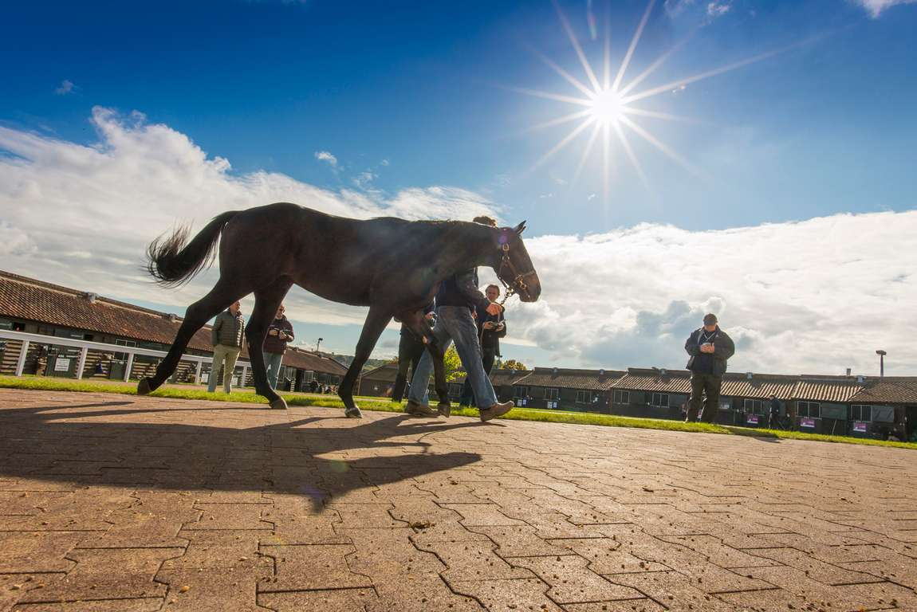

STAFF INDUCTION

Slide 2
INTRODUCTION

Slide 3

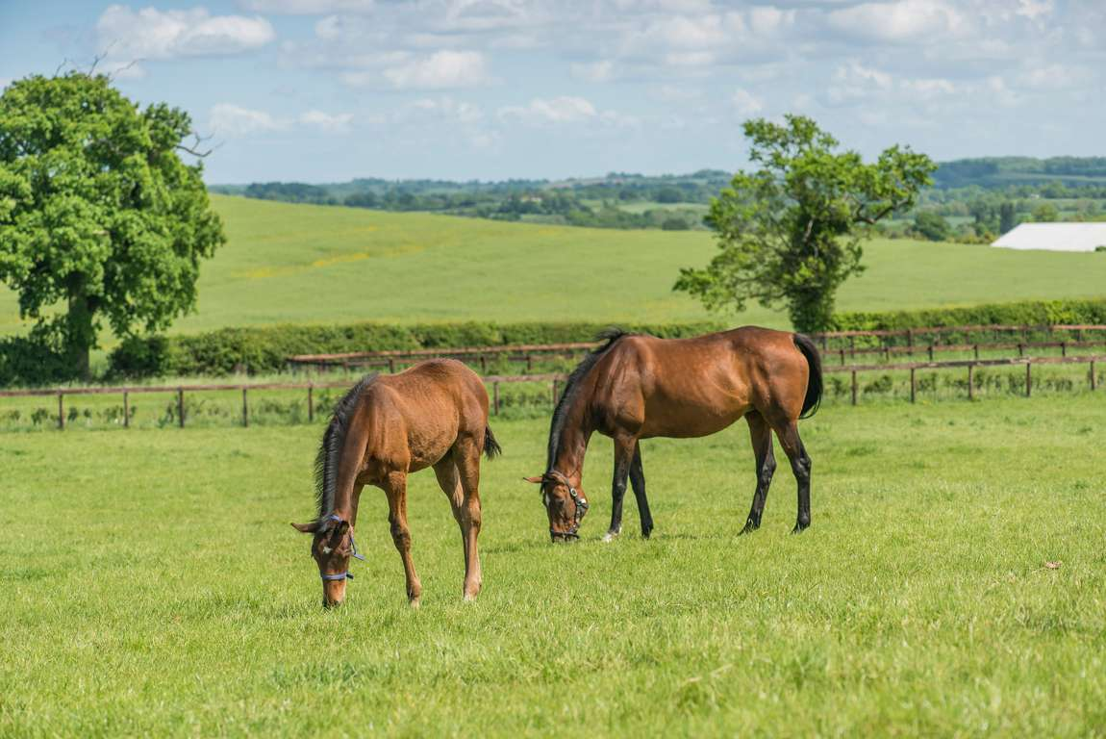
ABOUT OUR STUD
<Add Details>

Slide 4
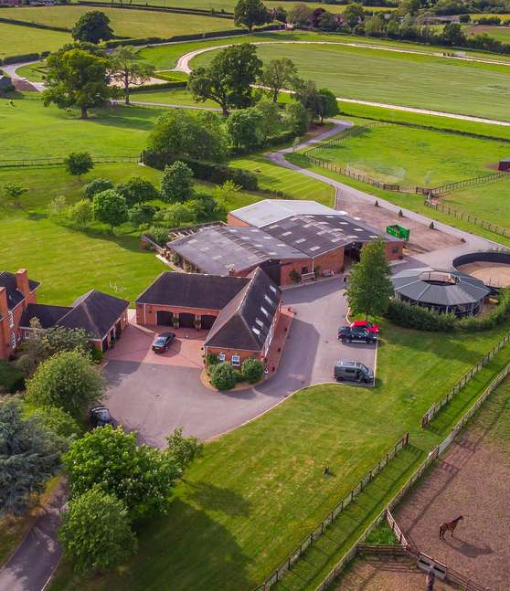
<Add details> Induction Presentation
WHO IS WHO?
Stud Manager: <add details>
xxx:<add details>
xxx:<add details>

Slide 5
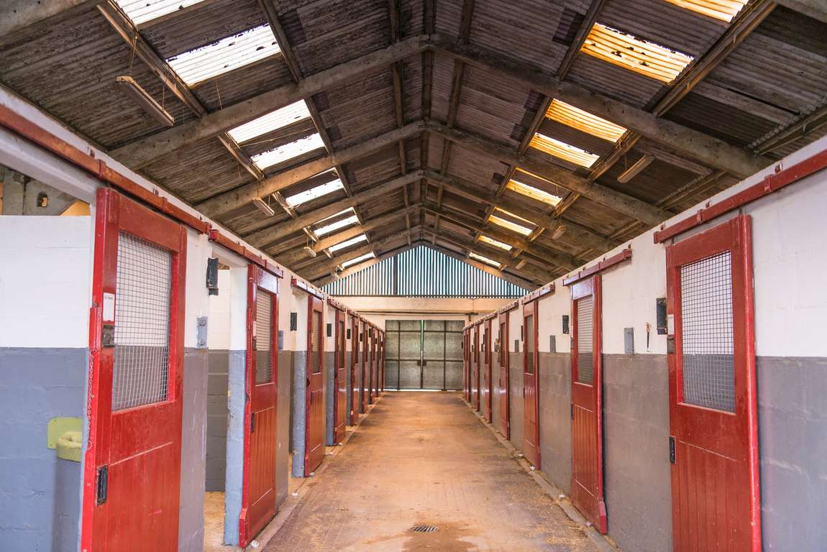
STUD OVERVIEW
GENERAL OVERVIEW OF YARD PRACTICES AND PROCEDURES:
Daily Routines: including schedules for tasks such as feeding, watering, mucking out, grooming, and tacking up. Turnout and stable management expectations.
Horse Handling Protocols: Handling procedures for different categories - mares, foals, stallions.
Specific Horse Information: Location of details regarding individual horses, including their temperament, dietary requirements, and any specific needs.

Slide 6
STUD LAYOUT AND FACILITIES
<Insert Site Plan>

Slide 7
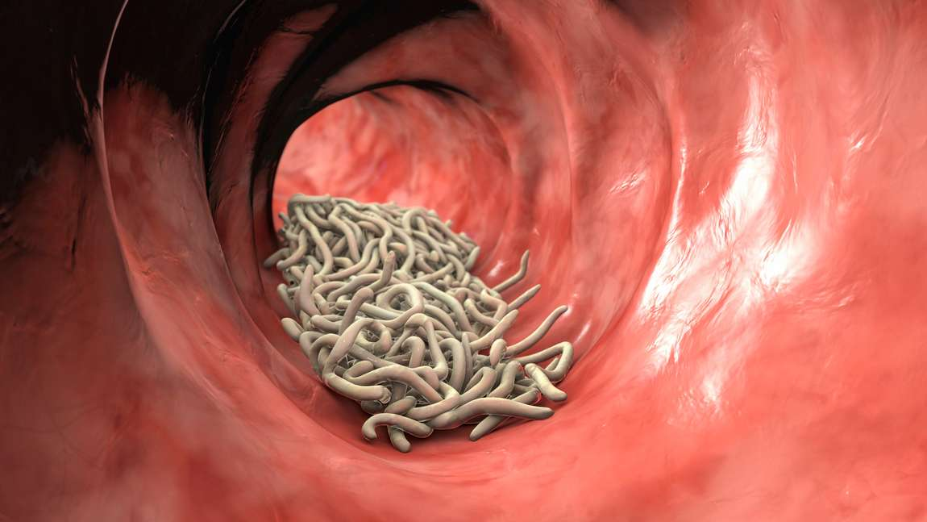
BIOSAFETY & DISEASE CONTROL
  Clothing protocols
  Isolation/ quarantine procedures for new or sick animals
  Vaccination and worming protocols
  Reporting of signs of illness or injury

Slide 8
HEALTH & SAFETY

Slide 9
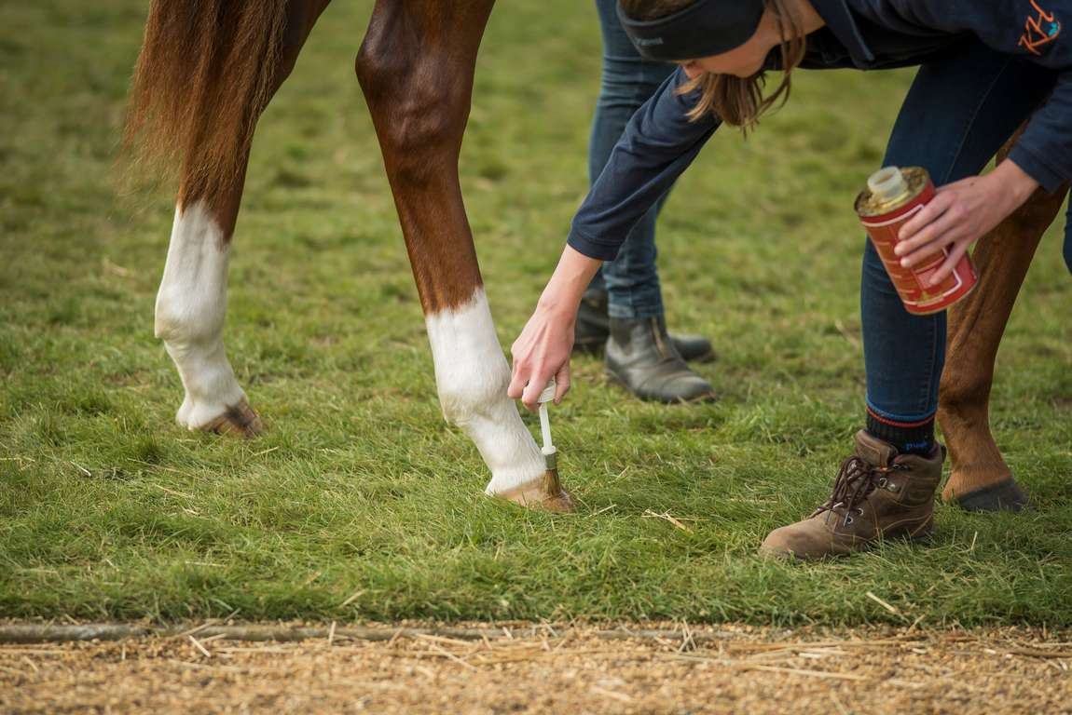
<Add details> Induction Presentation
HEALTH SAFETY
It’s not just a legal requirement!
  Reduces costs
  Promotes organisational efficiency
  Improves staff moral
  Reduces the risk of injury and ill-health
CULTURE
Health & Safety culture is a combination of the attitudes, values and perceptions that influence how something is actually done in the workplace, rather than how it should be done. Key factors are:
  Leading from the top
  Multi-directional communication
+2,4%
Biggest Project

Slide 10
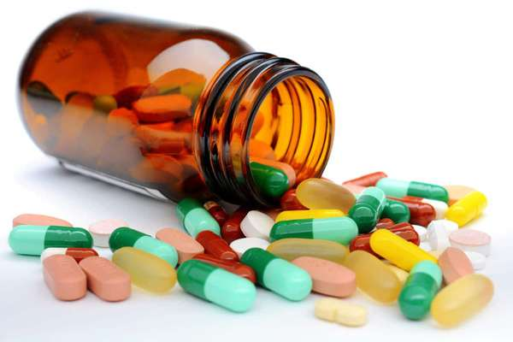
STUD POLICIES
Stud Rules
  A copy of the Stud rules, will be issued to each member of staff at this induction and displayed <add details>
  Daily routines and specific horse information will be made available prior to commencing work.
  All staff should comply with the requirements and culture of the yard. This includes health and safety.
Health Issues
  Inform the Stud Manager if you have a medical issue or take any prescribed medication which could affect your ability to work in a safe manner or the way first aid is administered.

Slide 11
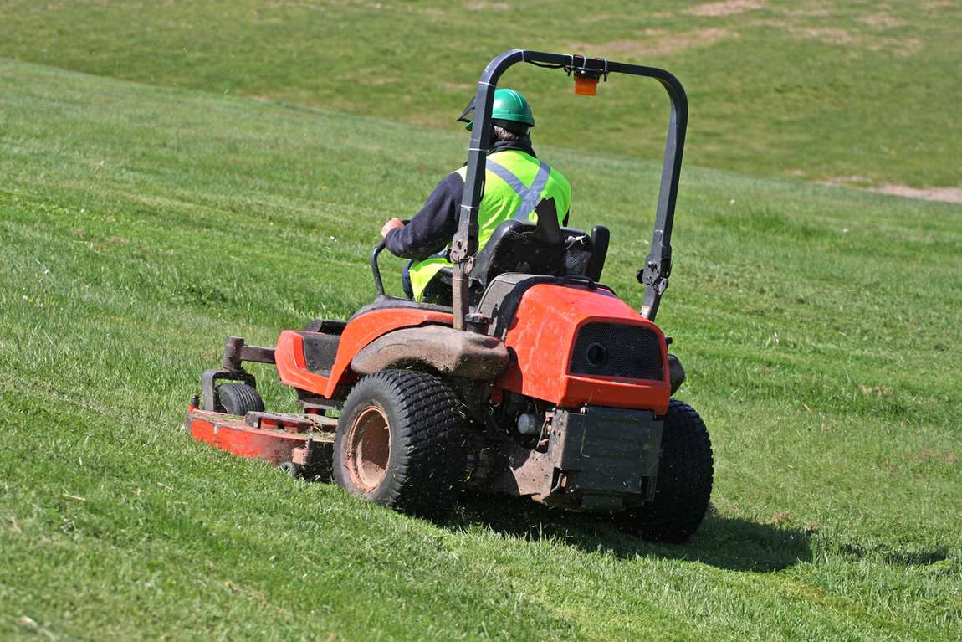
TRAINING & COMPETENCY
  Only operate machinery if trained to do so.
This includes tractors, quad-bikes, ride on mowers etc.
  The Stud Manager must assess staff competence and authorise the use of machinery.
Records of authorisation will be kept.
  All specific training needs will be identified and a training plan developed to allow
staff to fulfil their roles safely.

Slide 12
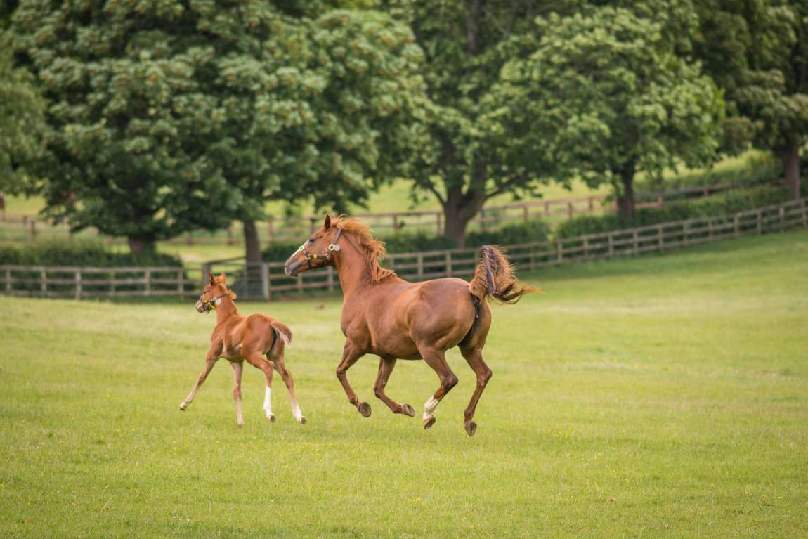
EQUINE HAZARDS
Health vs Safety
Traditionally safety has been seen as more important than health because the hazards are more immediate.
Health hazards can be more impactful than safety failures and unfortunately, individuals may not be aware of the consequences before it is too late.
If the hazards (anything that can cause harm) are understood it makes it much easier to control the risks (likelihood of harm).

Slide 13
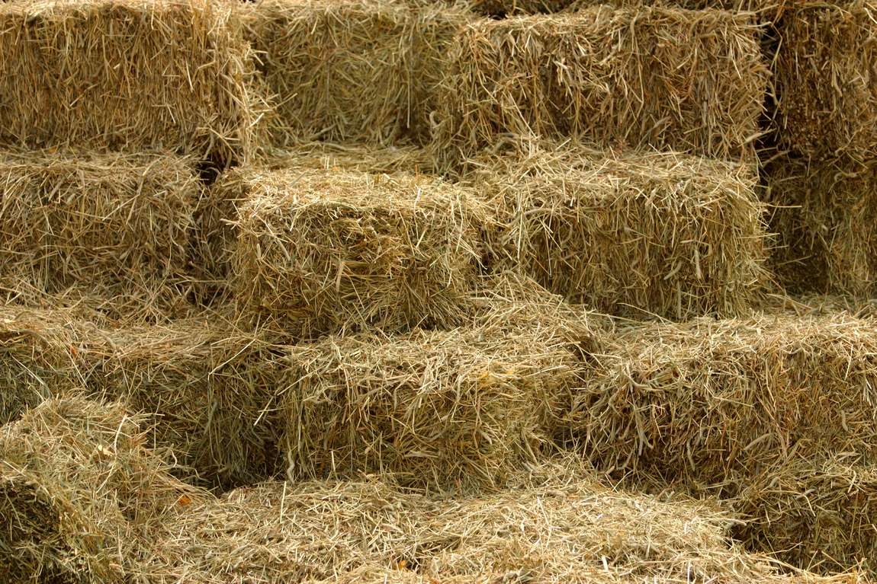
KEY HEALTH & WELLBEING HAZARDS
Respiratory Hazards
  Dust: occupational asthma and nasal cancers.
  Sand-based products: silicosis (scarred lung tissue).
  Horse dander: allergic reactions: allergic rhinitis, conjunctivitis, asthma.
  Mycotoxins and moulds: allergic reactions, infections, and long-term health issues like cancer.

Slide 14
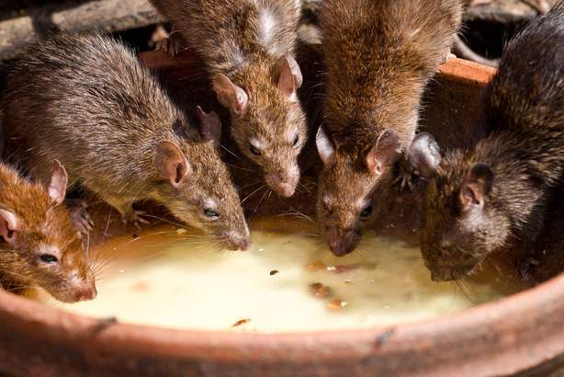
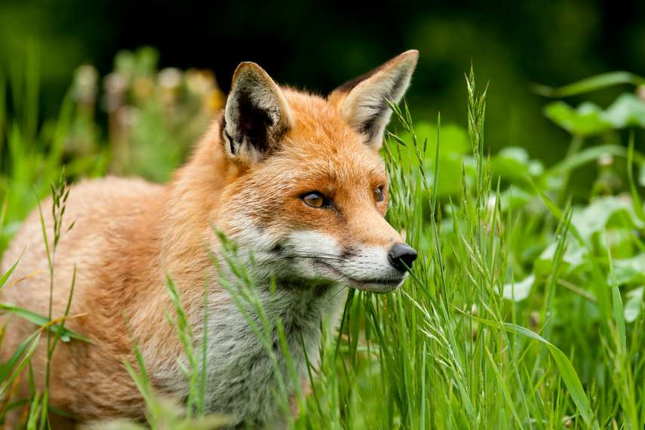
KEY HEALTH & WELLBEING HAZARDS
Infectious Diseases
There are a number of diseases that can be spread from horses to humans. These include:
  Ringworm
  Salmonella
  Streptococcus zooepidemicus
  Dermatophilus congolensis
  Glanders
  Hendra
Other diseases that may be present at stable yards are:
  Leptospirosis (Weils disease)
  Tetanus
  Lyme disease

Slide 15
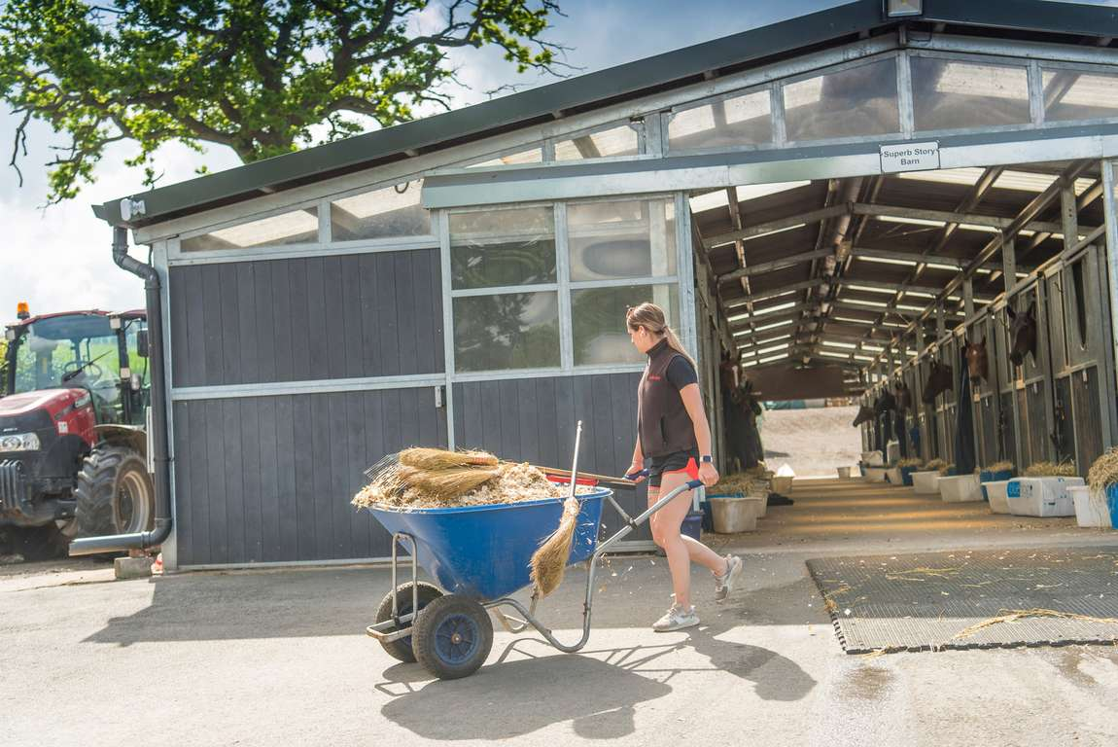
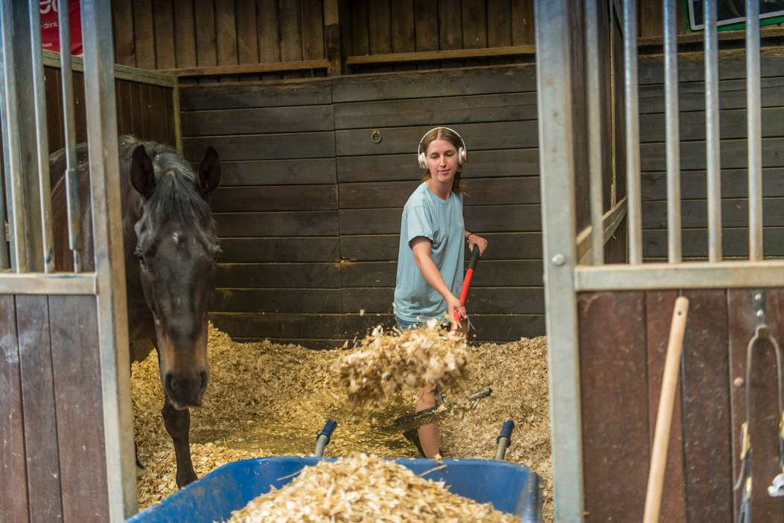
KEY HEALTH & WELLBEING HAZARDS
Muscuoskeletal Hazards
  Many activities within the equestrian industry involve manual handling.
These include: lifting hay bales / feed bags, pushing wheelbarrows, leading
/ handling horses.
  Injuries can occur when people are inexperienced or untrained and they fail
to plan a task properly.
  Tasks that involve twisting and turning into awkward positions or repetitive movements increase the risk of manual handling injury.
  Other significant manual handling risk factors, within the equestrian industry,
are slippery surfaces caused by inclement weather and the unpredictability
of horses’ behaviour.
  Cumulative musculoskeletal injuries can occur over time, the risk being exacerbated with tiredness and age.

Slide 16
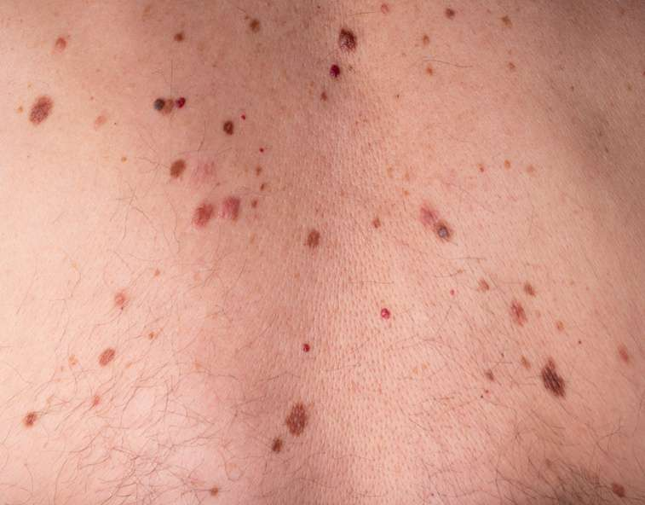
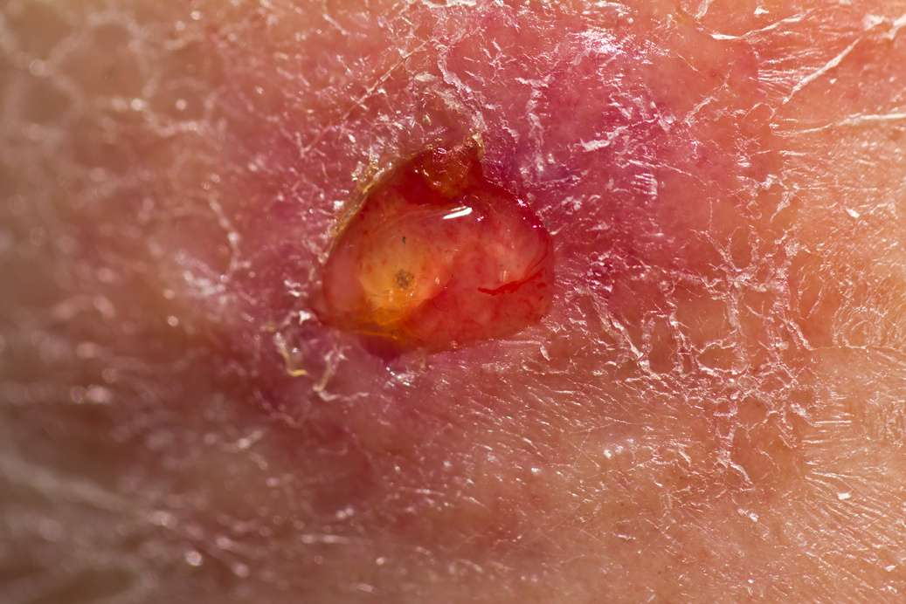
KEY HEALTH & WELLBEING HAZARDS
Adverse Weather
  Skin Cancer : exposure to the sun without appropriate protection.
  Dehydration : working in hot weather without adequate hydration symptoms can include headaches and cystitis (inflamed bladder)
  Slips, Trips and Falls: wet weather, snow and ice can lead to slippery conditions.
  Hypothermia: working outside in cold conditions. This can lead to clumsiness as fingers become numb.
  Chilblains: in severe cases these can lead to ulcers.

Slide 17

KEY HEALTH & WELLBEING HAZARDS
Poor Mental Health
  Stress: Stress is the body's response to pressure, triggering a "fight or flight" reaction. While brief stress can boost motivation, long-term stress harms health and may lead to burnout, anxiety, or depression.
  Depression: Depression is a serious mental illness marked by lasting low mood and loss of interest, affecting daily life.
  Anxiety: Anxiety is a natural reaction to stress or danger, but when it’s constant or disrupts daily life, it may be a sign of an anxiety disorder.
Poor mental health can affect relationships, work, physical health, and the ability to handle daily life.

Slide 18
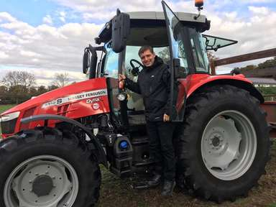
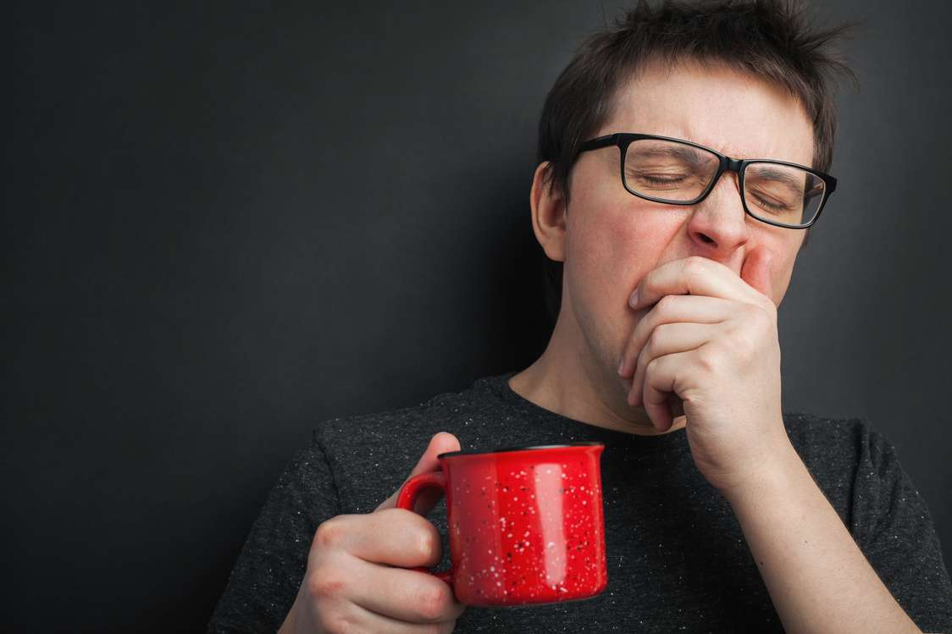
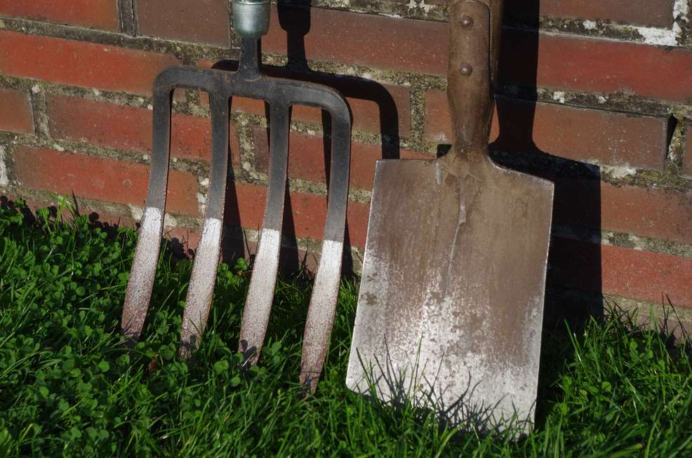
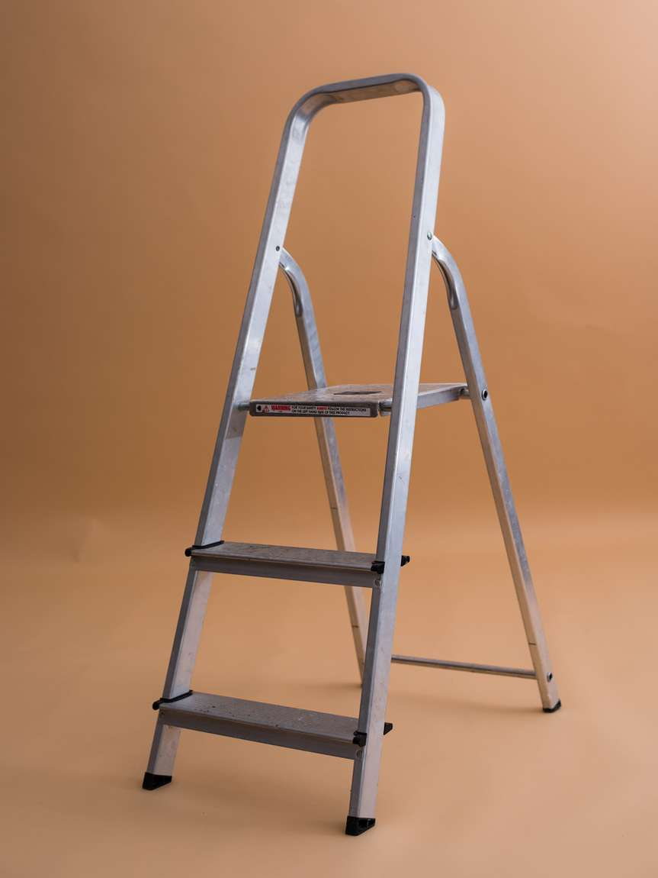
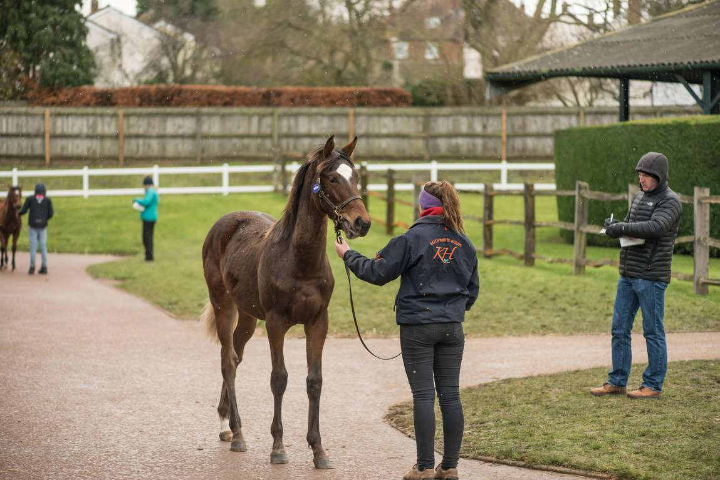
KEY SAFETY HAZARDS
  Driving & Vehicles: Using tractors, ride-on mowers, and quad bikes. Horseboxes and towing.
  Long Working Hours: The risk of accidents increases with tiredness.
  Machinery & Work Equipment: Injuries from moving parts, risk of crushing or entrapment etc.
  Falls from Height / Falling Objects: This includes falling from a horse.
  Adverse Weather: Slips, trips and falls. A horse being spooked whilst being led in windy conditions.

Slide 19
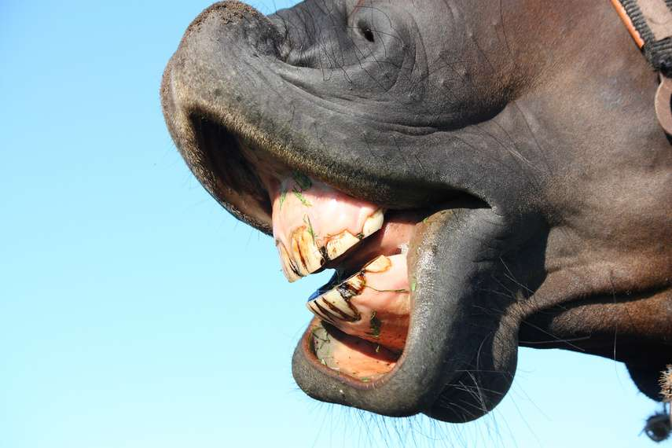
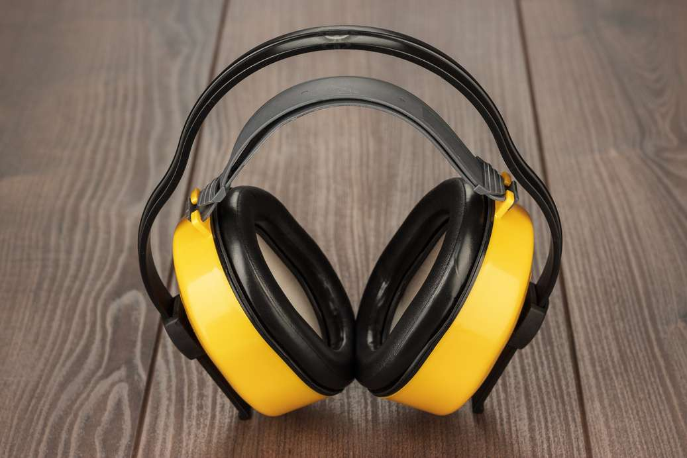
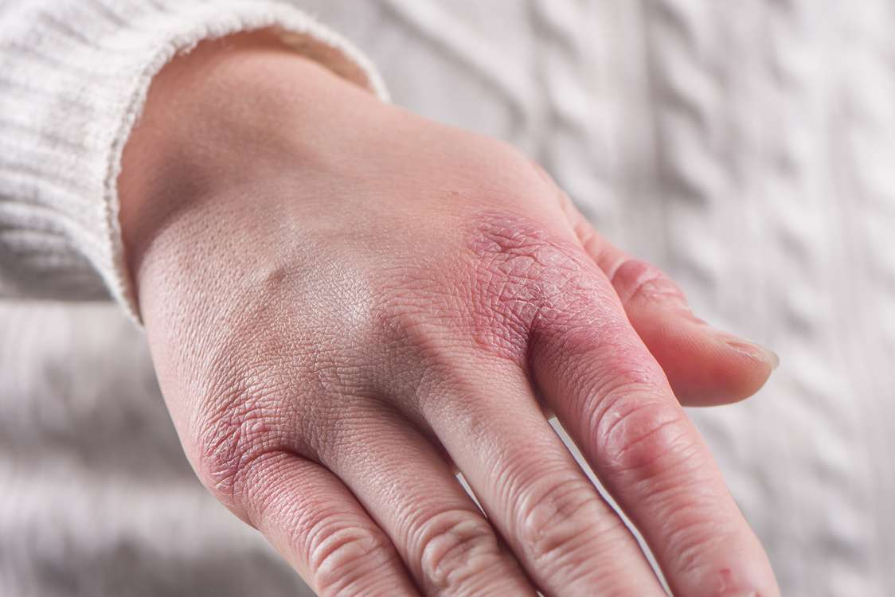
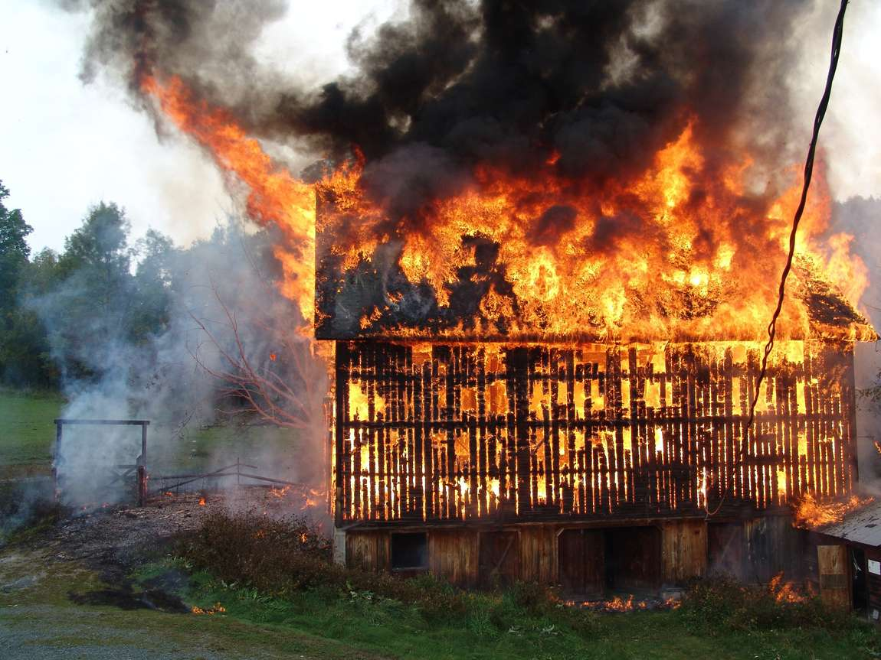
KEY SAFETY HAZARDS
  Injury from an animal: Bites, kicks and crush injuries.
  Hazardous Substances: Pesticides, insecticides.
  Noise: From equipment, including horse treadmills.
  Vibration: From work equipment such as clippers, leafblowers and mowers.
  Fire: There are a lot of combustible items at the stud. Geographical locations usually means that there is no access to water hydrants.

Slide 20
RISK ASSESSMENTS

Slide 21
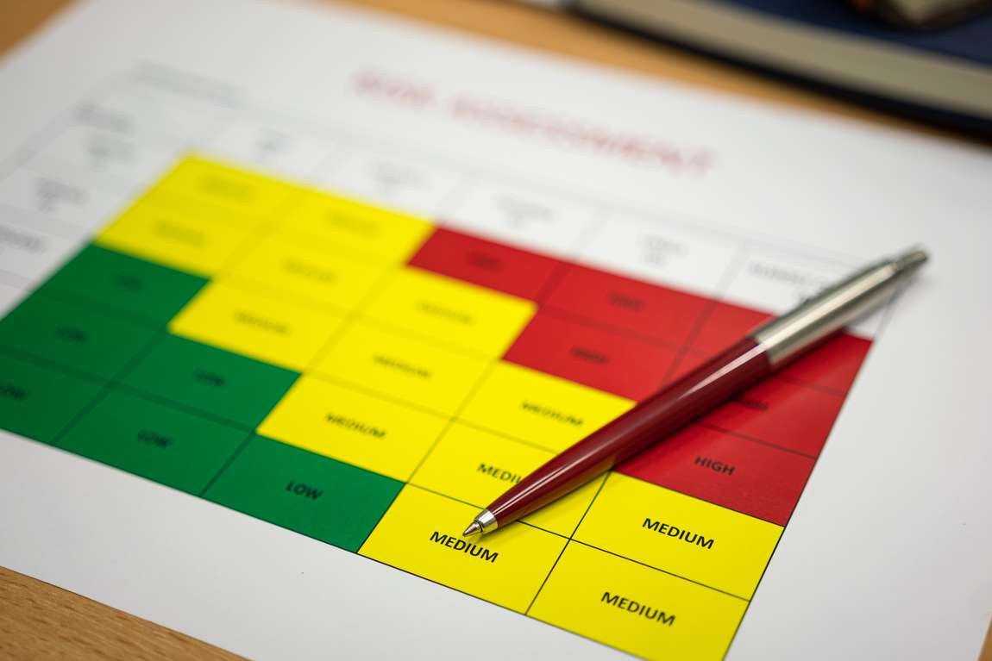
<Add Details> Induction Presentation
RISK ASSESSMENTS & METHOD STATEMENTS
  ‘Suitable and sufficient’ risk assessments should be in place for any work activity with a significant hazard e.g working with stallions, handling foals, lone working.
  Risk Assessments and will be reviewed and updated by the Stud Manager.
  Risk Assessments are available <add details>
  Staff should follow any control measures in the risk assessments to ensure that risks to health and safety are minimised.
Learn More

Slide 22
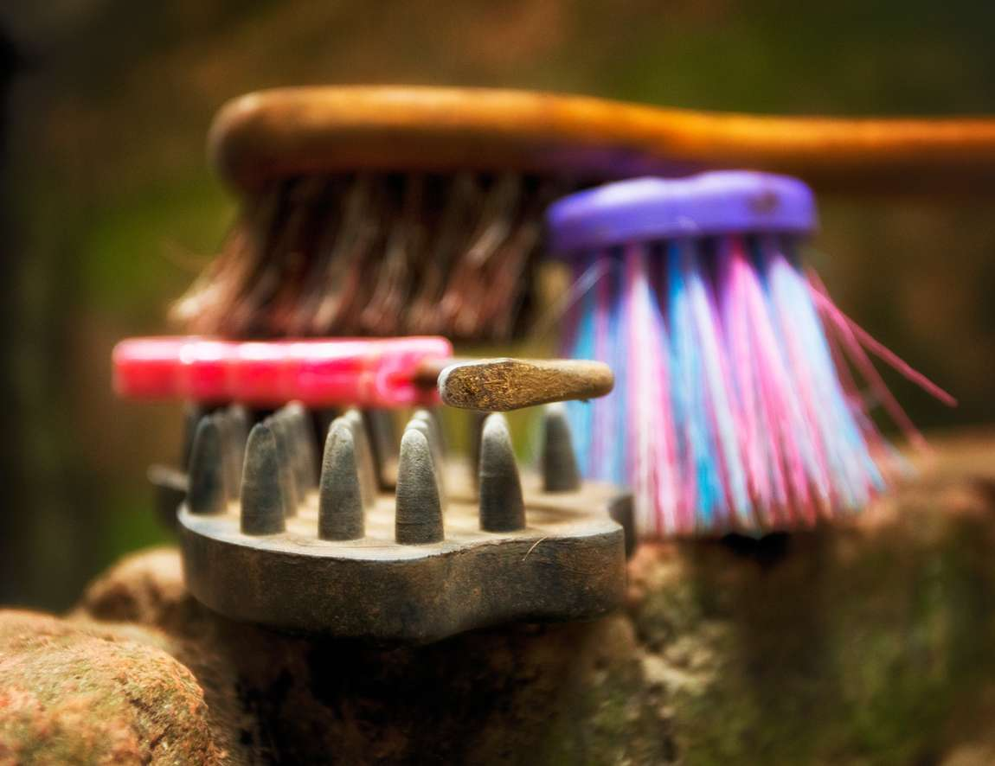
<Add details> Induction Presentation
WORK EQUIPMENT
All work equipment must be:
  Inspected before use and any faulty items removed from site.
  Only used as intended by the manufacturers.
  Subject to any mandatory testing e.g portable electrical (PAT) testing.
  Used only by competent persons.

Slide 23
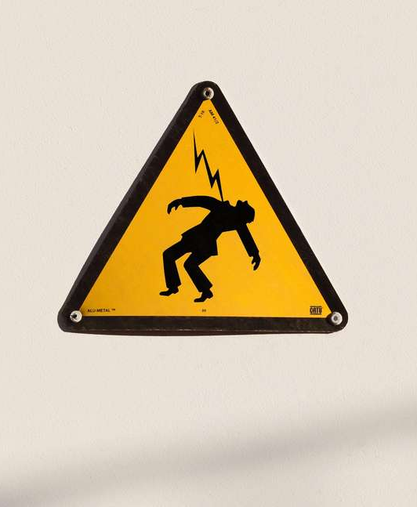
<Add Details> Induction Presentation
ELECTRICAL SAFETY
  Where possible use battery operated equipment.
  Don’t overload sockets.
  Only use electrical items in the environment where they are intended.
  Always use an RCD when using electrical items outside.
  Take care when using using extension leads, especially when leading horses near them. Where possible these should be ramped or flown.

Slide 24
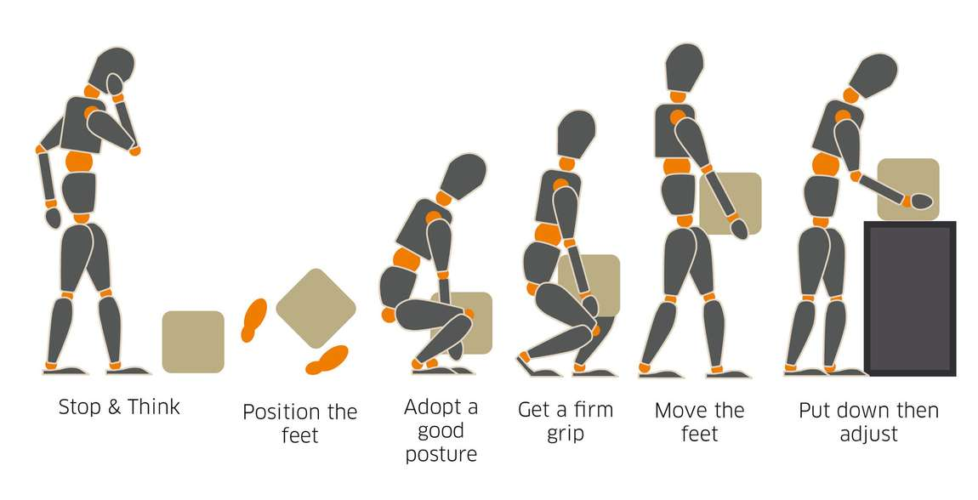
<Add Details> Induction Presentation
GENERAL MANUAL HANDLING
  Manual handling should be avoided where possible.
  Mechanical handling aids should be used where possible.
  The weight of loads should be established prior to lifting, with loads broken down into smaller loads where appropriate.
  Staff should be trained in good manual handling techniques:
    Keep back straight and maintain good posture
    Use the leg muscles to lift
    Keep the load close to your body
    Use a firm palm grip
    Keep elbows tucked into the body
    Position feet to provide a stable base

Slide 25

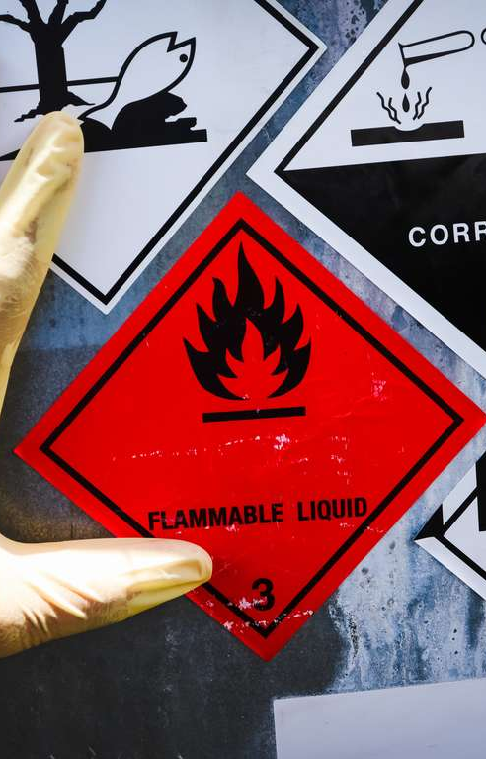
<Add Details> Induction Presentation
HAZARDOUS SUBSTANCES
COSHH Assessments and Manufacturers Hazard Data Sheets should be available for all hazardous substances. Only the required amounts should be brought to site.
Appropriate arrangements should be in place for:
  Storage
  Use
  Spillages
  Disposal
Wood dust is a hazardous substance that causes nasal cancer and occupational asthma. There should be no dry sweeping of wood dust and tools should have appropriate extraction.

Slide 26
VEHICLES
  Speed limits: <add details>
  Parking areas: <add details>
  Driver training / tractor and machinery use: <add details>
  Engine noise/idling: Engines should be switched off when parked.
  Horse transportation: Payloads must not be exceeded.<add details>
  Reversing vehicles: All reversing lorries should have a banks person.
  Maintenance logs: Maintenance logs are located <add details>

Slide 27

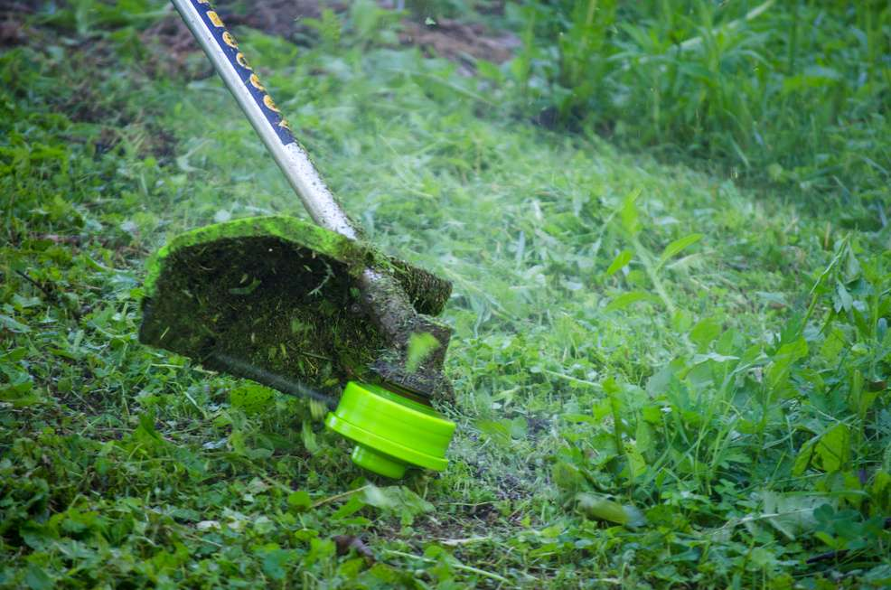
NOISE & VIBRATION
  Noise: Exposure to excessive noise can lead to hearing loss.
Hearing protection must be worn if noise levels are above 85dBA.
Details of activities where hearing protection should be worn are contained in
the risk assessments.
  Vibration: Using hand-held vibrating equipment can cause permanent damage to nerves and circulation in the hands. Examples of vibrating equipment include pressure washers, leaf blowers and mowers. The use of vibrating equipment needs to be logged and managed, with any symptoms of numbness, pins and needles, tingling in the fingers reported to <add details>.

Slide 28




PERSONAL PROTECTIVE EQUIPMENT (PPE)
Some activities require the wearing of PPE. These are identified in the risk assessments. This can include:
Safety Footwear
Hard Hat
Hi-vis Jacket/ Vest
Gloves

Slide 29
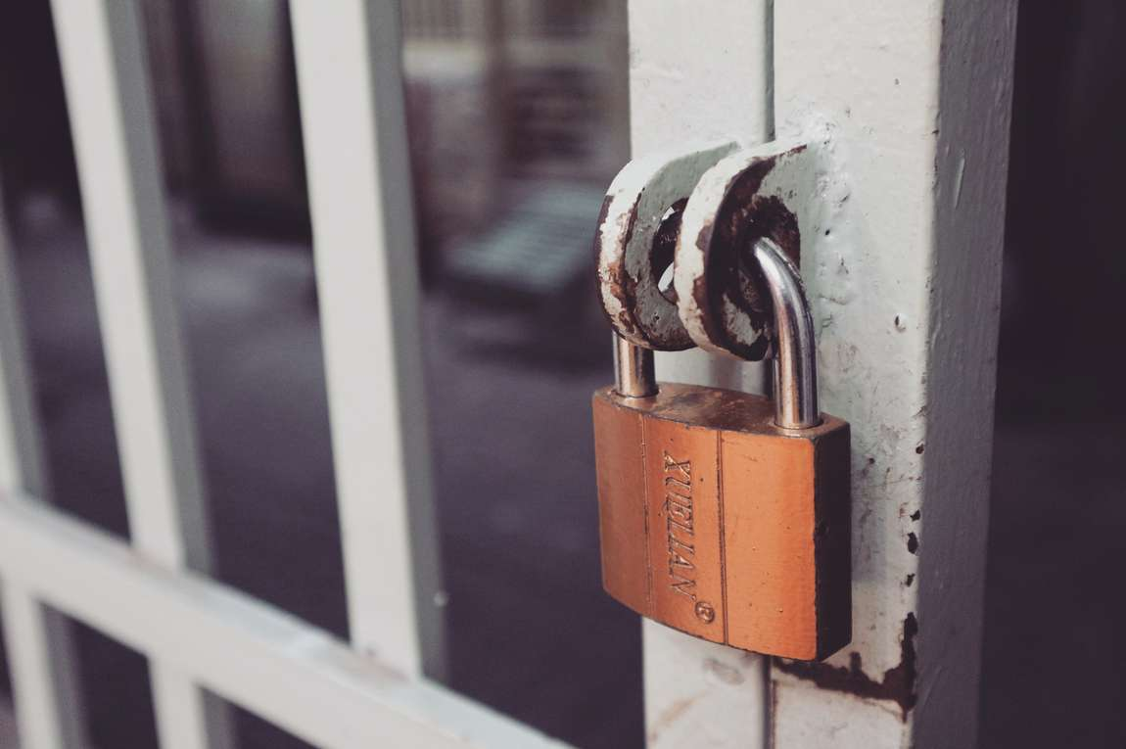
<Add Details> Induction Presentation
PUBLIC SAFETY & SECURITY
  Signing in/ out procedures
  Controlled areas (e.g stallion boxes, foaling units)
  Key holding responsibilities
  CCTV and alarm systems
  Measures to prevent horses escaping.
Learn More

Slide 30
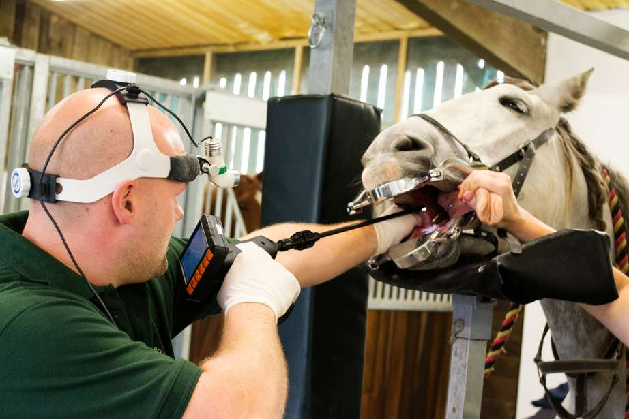
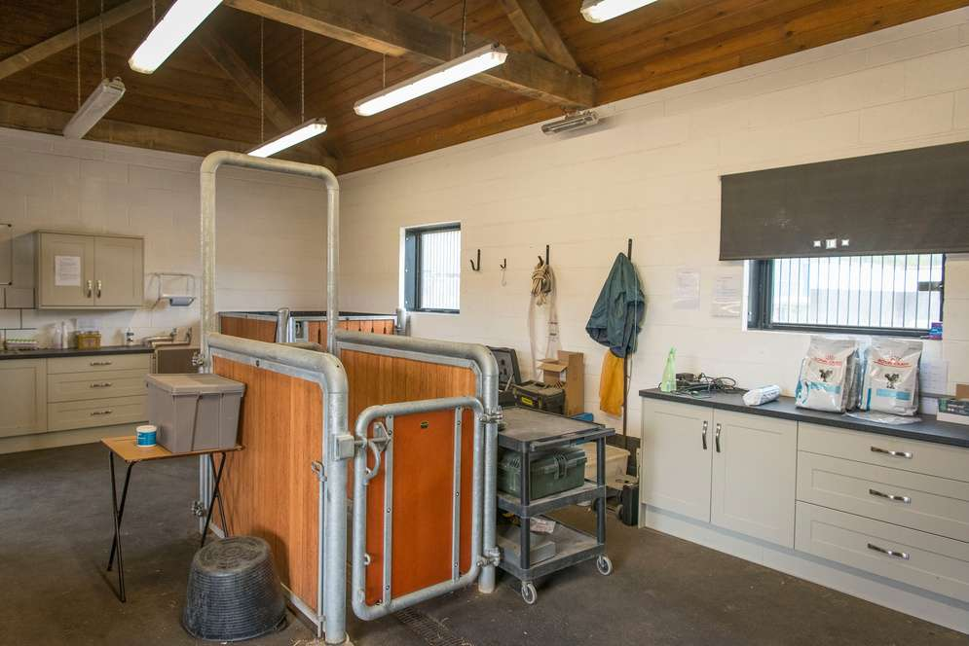
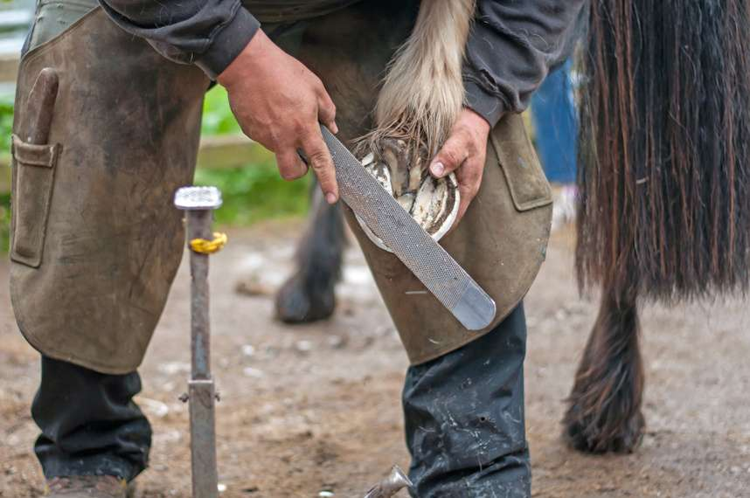
<Add Details> Induction Presentation
USING CONTRACTORS
In the equine industry, contractors are commonly used for various specialised tasks and services, ranging from construction and maintenance of facilities to providing horse care. These include:
  vets
  farriers
  equine therapists
  dentists
  horse transporters
Businesses using contractors are responsible for ensuring a safe working environment for them. It is essential that all contractors have appropriate levels of insurance.

Slide 31
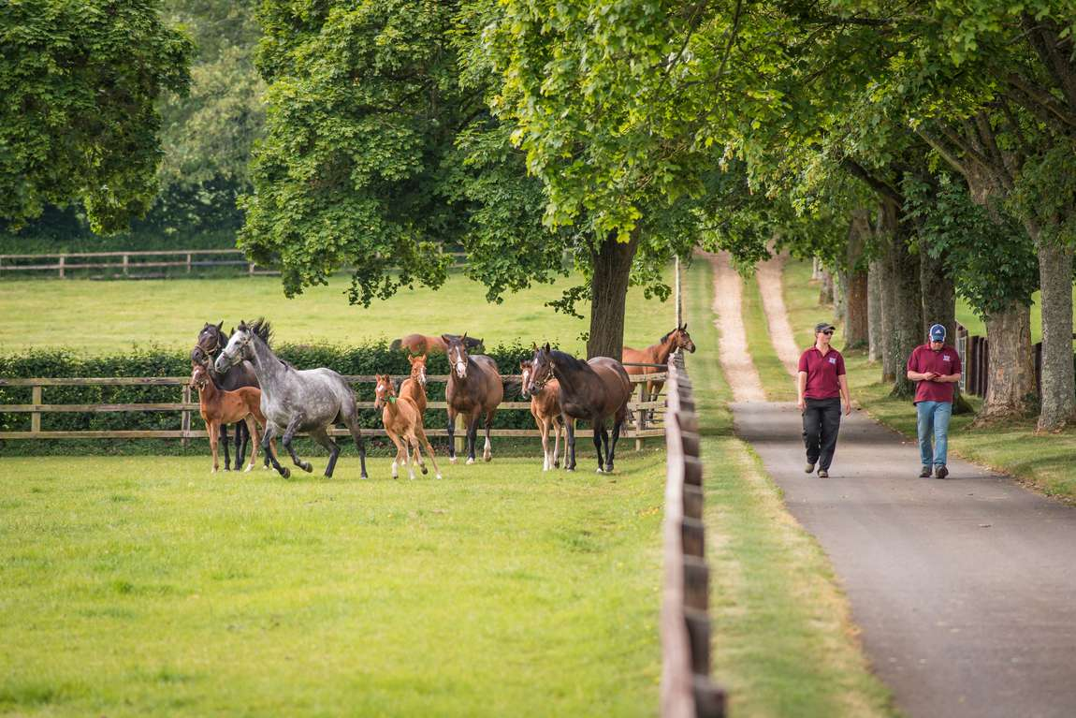
VISITORS
  Clients: <add details of visitor arrangements including restricted areas>
  Children: <add details of visitor arrangements including restricted areas>

Slide 32

Wellbeing
Health:
  Physical health - Sleep, diet and exercise
  Physical safety - Safe working practices, safe equipment, safe environment.
  Mental health - Stress management, support to manage mental ill health.
Good Work:
  Working environment - Appropriate working areas, open and inclusive culture.
  Good line management - Effective people management policies, training for line managers, sickness absence management.
  Work demands - Job design, job roles, job quality, workload, working hours, job satisfaction, work-life balance.
  Autonomy - Control, innovation, whistleblowing.
  Change management - Communication, involvement, leadership.
  Pay and reward - Fair and transparent remuneration practices, non-financial recognition.
Wellbeing is not just the absence of ill health. It includes the way that people feel about themselves and their lives.

Slide 33
Wellbeing Resources
<add details>

Slide 34
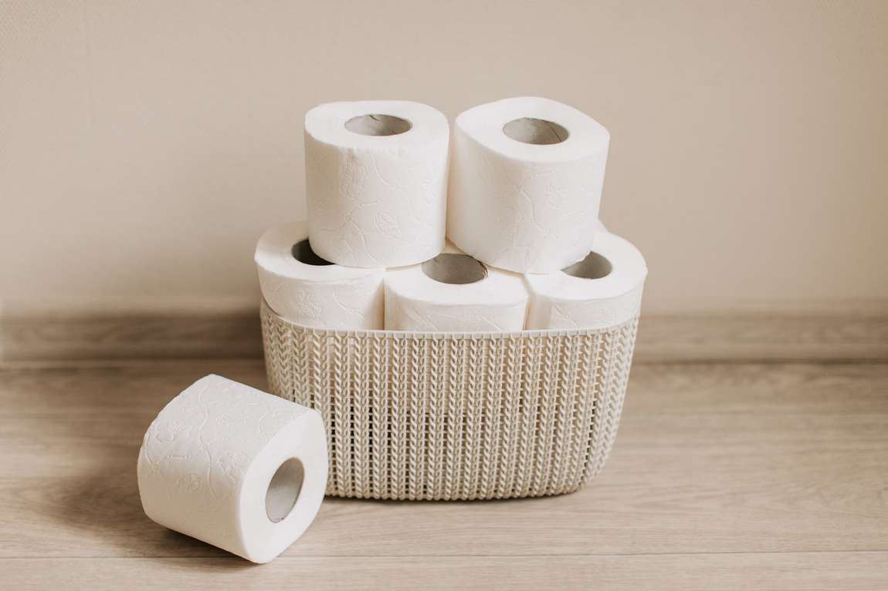
<Add details> Induction Presentation
WELFARE
  Toilets and handwashing facilities are located <add details>
  Facilities to eat meals are located <add details
  Drinking water is available <add details>
Learn More

Slide 35
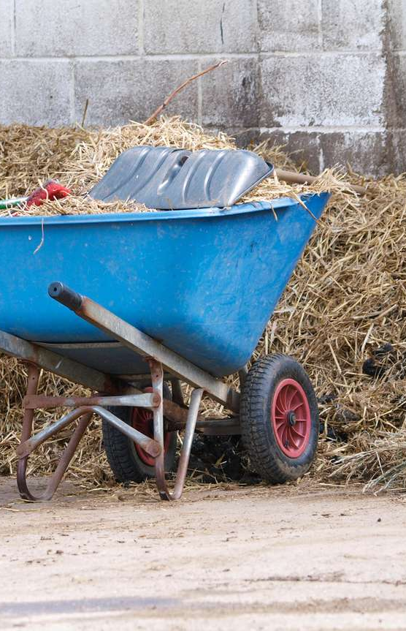
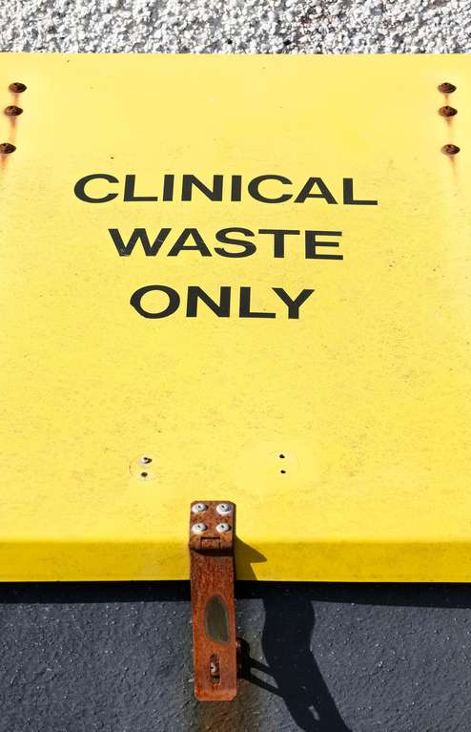
WASTE
Muck heaps:
Horse manure and soiled bedding should be stored in designated areas away from watercourses, wells, and drainage systems to prevent contamination.
Muck heaps pose a risk of fire due to the potential for spontaneous combustion. This occurs when the heat generated by the decomposition builds up faster than it can be dissipated.
Veterinary waste:
Appropriate arrangements are in place for the disposal of clinical, sharps, and pharmaceutical waste. Details of waste processes can be found <add details>

Slide 36
EMERGENCY ARRANGEMENTS

Slide 37
ARRANGEMENTS
  First Aid
  Fire

Slide 38
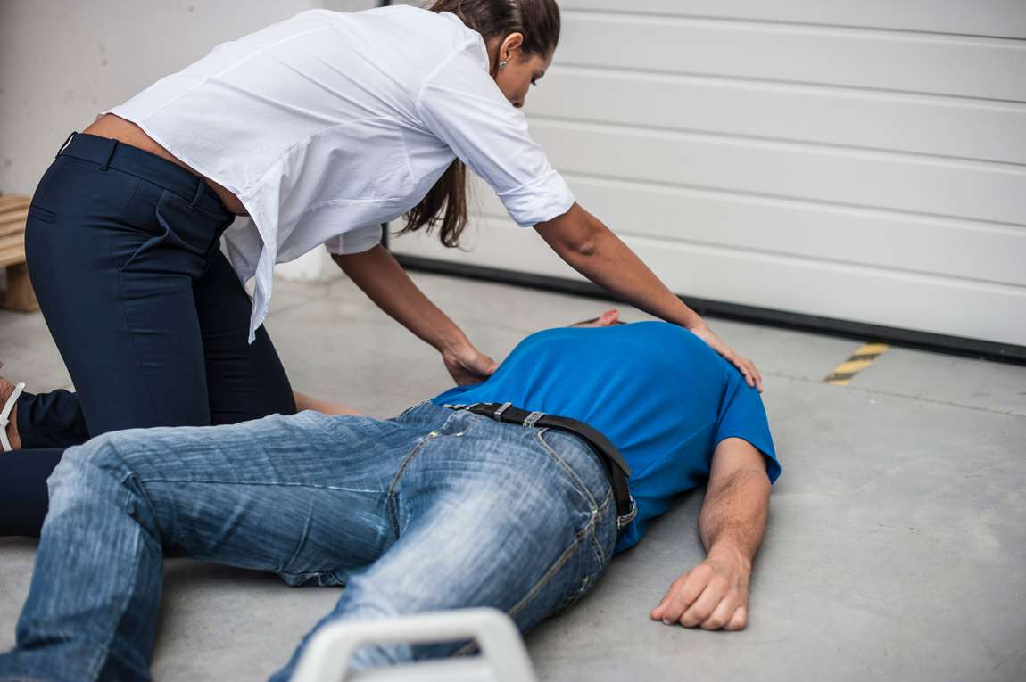
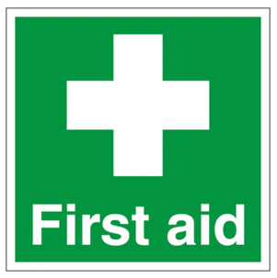
<Add details> Induction Presentation
FIRST-AID
  The trained first-aiders are: <add details>
  The First-aid kit is available <add details>
  Notify the Stud Manager if you are involved in an accident/ incident (near-miss) or think that you have been made unwell due to your working environment.
  All accidents should be recorded in the Stud Accident Book, which is located <insert details>.
Learn More

Slide 39
<Add Details> Induction Presentation
NEAREST HOSPITAL
<add details and map>

Slide 40

EXAMPLES OF INCIDENTS (NEAR MISSES)
  Narrowly missing a pedestrian when reversing a tractor.
  Discovering a mare is foal proud after experiencing aggressive behaviour.
  Nearly being struck by a falling item.
  Finding contractor equipment left in a stable.

Slide 41
<Add details> Induction Presentation
FIRE PRECAUTIONS
Prevention is the most effective form of fire safety:
  Good housekeeping prevents fires.
  Avoid accumulating waste.
  Don’t overload sockets.
  Ensure electrical equipment is PAT tested.
  Only use electrical items in the environment where they are intended. RCD’s should always be used when using electrical equipment outside.
  Store gas cylinders appropriately.
  Only smoke in designated outside areas.
  Ensure muck heaps are positioned away from buildings.
Learn More

Slide 42

FIRE EVACUATION PROCEDURE
If you discover a fire:
  Raise the alarm
  DO NOT TACKLE A FIRE UNLESS YOU HAVE BEEN TRAINED
  Call the fire brigade (999) and inform the <add details>
Upon hearing a fire alarm, staff should:
  Evacuate the area by the nearest, safe and effective evacuation route
  Ensure any visitors evacuate.
  Proceed to the Assembly Point.
  Do not stop to collect personal items / belongings.
  Report any signs of smoke.
  Do not re-enter area until told it is safe to do so.
  Do not attempt to drive off site.
Equine evacuation:
<add details>

Slide 43
FIRE EVACUATION PROCEDURE
The Fire Assembly Point is located <add map and details of equine evacuation arrangements>

Slide 44
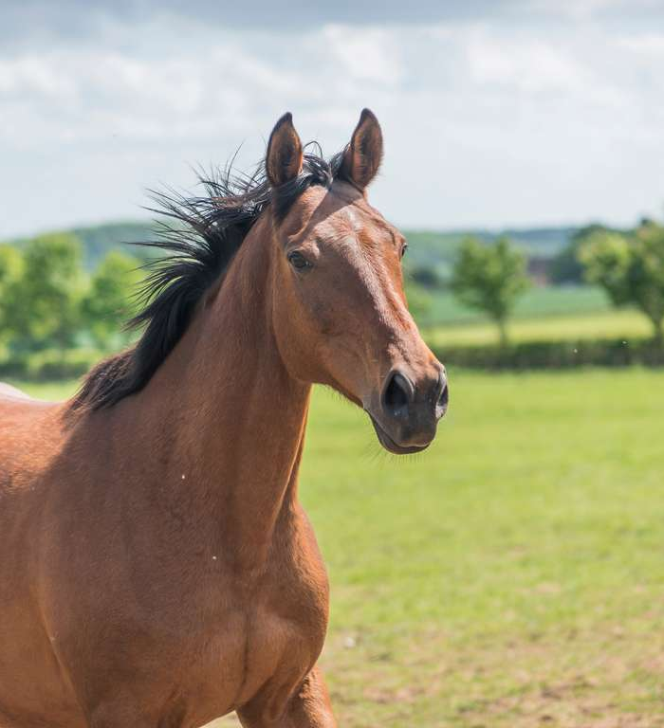
<Add Details> Induction Presentation
QUESTIONS
There is no such thing as a stupid question.
If you don’t know, you don’t know......
In health and safety you need to know!

